Slide 1
Basic Details of the Team and Problem Statement
Ministry/Organization Name/Student Innovation:
BENGAL INSTITUTE OF TECHNOLOGY
PS Code: SBHRCCIIT026
Problem Statement Title:
Facial and visual analytics to detect mental stress or emotion
Team Name: THREE DEGREE
Team Leader Name: SIDDHANT SHARMA
Institute Code (AISHE): C - 6294
Institute Name:
BENGAL INSTITUTE OF TECHNOLOGY
Theme Name: AI/ML AND SMART AUTOMATION

Slide 2
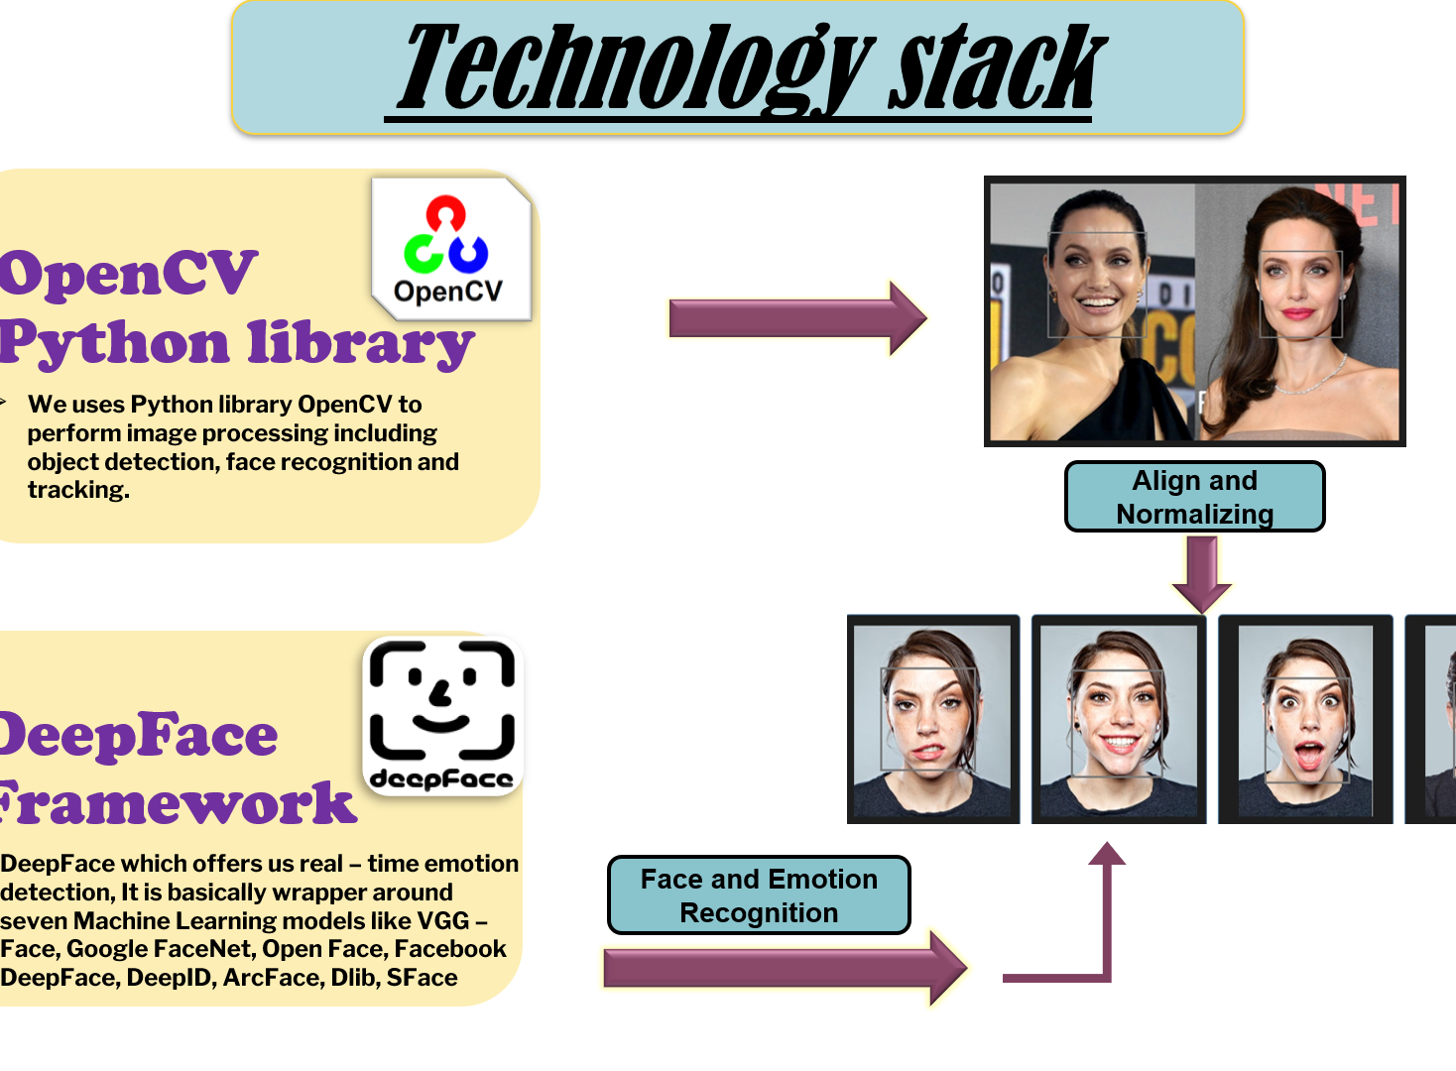
Idea/Approach Details
To develop a framework which can detect facial expression of any person through camera and will tell us the emotion of the person.
The analysis was focused mainly on non-voluntary and semi-voluntary facial cues in order to estimate the emotion representation more objectively.
Features under investigation included eye-related events, mouth activity, head motion parameters etc estimated through camera-based photoplethysmography.
A feature selection procedure is employed to select the most robust features followed by classification schemes discriminating between stress/anxiety and neutral states with reference to a relaxed state in each experimental phase.
Technology Stack :
In this we uses Python library OpenCV to perform image processing including object detection, face recognition and tracking.
We are using a framework name DeepFace which offers us real – time emotion detection, It is basically wrapper around seven Machine Learning models.
Our model detects, align , normalize, represent and verify for face recognition.

Slide 3
Idea/Approach Details
Use Cases
Describe your Dependencies / Show stopper here
It can detect the emotions of a person through their facial expressions. Detected emotions can fall into any of the six main data of emotions: happiness, sadness, fear, surprise, disgust, and anger.
Reduces the stress associated with lengthy typed reviews by enabling the user to identify emotions for real-time lie detection and fraudulent behaviour, as well as a future potential for automatically created reviews on customer satisfaction for products.
In future we will put a feature in our software where it can detect whether a person is in depression or any kind of stress or not.
In our software voice detection feature will be there, where the software can detect the stress or anxiety level trough voice.
We will deploy it to our website in future updates where a user can easily use this software.
We will add a feature in our model through which it can detect the problems according to that it will provide resolution which will available in our website.

Slide 4
Team Member Details
Team Leader Name: SIDDHANT SHARMA
Branch (Btech/Mtech/PhD etc): Btech Stream (ECE, CSE etc): IT Year (I,II,III,IV): II
Team Member 1 Name: DISHA MAKAL
Branch (Btech/Mtech/PhD etc): Btech Stream (ECE, CSE etc): CSE Year (I,II,III,IV): II
Team Member 2 Name: RAHUL PAL
Branch (Btech/Mtech/PhD etc): Btech Stream (ECE, CSE etc): CSE Year (I,II,III,IV): II
Team Mentor 1 Name: AJANTA PALIT
Category (Academic/Industry): ACADEMIC Expertise (AI/ML/Blockchain etc): AI Domain Experience (in years): 5

